Slide 1
RDA Copy Cataloging Training
East Carolina University
August 29, 2013

Slide 2
Background
Patricia Dragon

Slide 3
RDA is not coming. It’s here.
System has been configured to accept new fields. Display and indexing are works in progress.
About 6000 RDA records are already in Symphony.
The number of RDA records in Symphony has skyrocketed after LC day one.
Notes:
Patricia
Thanks to Ann Carol, working over the past year or so, several MARC updates. Won’t get errors. Still have to make decisions on what fields need to display where or be indexed in the title or keyword index, etc., including mapping for Summon.
The 6000 figure was from early July so it’s probably more. Already your friends; you’ve seen them, whether or not you noticed.
LC day one was March 31, 2013. Day after which no more AACR2 originals may be created by LC. Other libraries had/have their own day ones, some before LC. Remember all the webinars and introductions we did in 2010, 2011 when RDA was just something that would happen someday?

Slide 4
OCLC RDA Policy Statement
Originals may be entered according to any cataloging code.
One record per manifestation per language of cataloging.
For access points use LCNAF.
Do not change master records from RDA back to AACR2.
Libraries MAY upgrade master records from AACR2 to RDA.
As always, when editing for your local system, you can do whatever you want.
For more information, see OCLC RDA Policy Statement
Notes:
Patricia
OCLC is not forcing anyone to switch to RDA (nor did they force anyone to switch to AACR2). Both standards will co-exist.
Just like always, if you don’t like the way something was cataloged, you can edit the record, you can’t create a new one.
Whatever form the LCNAF has, RDA or AACR2. Authority records are being changed over to RDA, slowly. But use whatever access point is current.
Do not change master records back to AACR2.
May upgrade to RDA but libraries are not required to.

Slide 5
Local upgrade policy
In general, accept both AACR2 and RDA copy and do not edit to one from the other.
When upgrading a master record to the extent of recataloging an item, upgrade master record to RDA (requires original cataloger).
When deriving a new master record, new record should be in RDA (requires original cataloger).
Do not upgrade to RDA without replacing the master record.
Eastern Carolina Network day one for RDA originals will be January 1, 2014.
Notes:
Patricia
Both codes will co-exist in Symphony for a long time.
Not just adding call number, subject headings, correcting typo, changing Elvl. I mean, the record is super-minimal; vendor record, Elvl=3, etc.
Requires original cataloger, so if that is not you, follow whatever procedure you usually follow for originals.
Don’t upgrade only locally.
Training for those doing original cataloging will happen this fall. Probably one on one or small groups, as everyone is doing slightly different things.

Slide 6
RDA Copy Cataloging Field by Field Guidelines
Marlena Barber
Chris Holden
Jan Mayo

Slide 7
Recognizing an RDA Record
An RDA record can be recognized through the combination of the “Desc” fixed field and the 040 field.
The “Desc” field will be “i”
The 040 field will have a “$e rda” present.

Slide 8
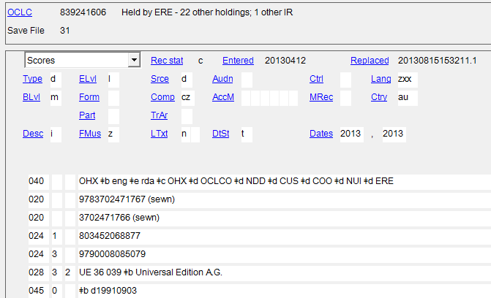

Slide 9
MARC Tag 245 $a
Title proper
245 | 1 0 | EVERYTHING IS MISCELLANOUS: $b THE POWER OF THE NEW DIGITAL DISORDER / $c David Weinberger.
245 | 1 0 | Everything is miscellaneous : $b the power of the new digital disorder / $c David Weinberger.
Notes:
RDA does continue to use standard sentence case in the Title Proper as we have seen in AACR2. But, when copy cataloging the Title Proper subfield a, you would not need to take the time to change the capitalization to sentence case unless you see an entry in the record transcribed in all CAPS like we see here.

Slide 10
MARC Tag 245 $a
Title proper
AACR2
245 | _ 0 | Speling [sic] errors.
RDA
245 | _ 0 | Speling errors.
Notes:
The title is transcribed as it appears on the resource in RDA. Unlike in AACR2, RDA does not use [sic] to highlight a misspelling.
If the inaccuracy appears on the title itself, and a corrected form of the title is considered important for identification or access, you would create a variant title with the correct information.

Slide 11
MARC Tag 245 $h
General material designation (GMD)
245 | 1 2 | A tale of two cities $h [electronic resource]
Notes:
RDA does not allow for $h in 245. The content this tag contained is now addressed in the item type field within the fixed fields and in the new 336, 337, and 338 fields.

Slide 12
MARC Tag 245 $c
Statement of responsibility
AACR2
245 | 1 0 | Library life / $c by Michael Gorman… [et al.].
RDA
245 | 1 0 | Library life / $c by Michael Gorman [and three others].
245 | 1 0 | Library life / $c by Michael Gorman, Melvil Dewey, J. Edgar Hoover, and Madeleine L’Engle.
Notes:
You will no longer see et al. in the statement of responsibility area for when the number of authors is more than three. Just recording the first listed author’s name is required in RDA, but this subfield can now display an unlimited amount of authors. So, if you see more than three authors in that subfield of a record you are copy cataloging, that is okay, and you would not need to remove anyone’s names from that subfield.

Slide 13
MARC Tag 246
Varying form of title
Keep or create an entry for added access.
245 | 10 | Cataloger’s guide to Functional Requirements of Bibliographic Records & Resource Description and Access.
246 | 3 _ | Cataloger’s guide to Functional Requirements of Bibliographic Records and Resource Description and Access
246 | 1 8 | Cataloger’s guide to FRBR and RDA
Notes:
Just as in AACR2, the Varying form of title field is needed for when the title has a misspelling, to add access for abbreviated words, when an ampersand is located in the 245, and for additional titles located on the physical title. Verify that it is correct. Add a 246 if one is not in the record if it is needed and not present.

Slide 14
MARC Tag 246
Varying form of title
Opportunity to address the spelling errors in the Title Proper.
246 | 3 _ | Spelling errors
Notes:
Just as in AACR2, this field is needed for when the title has a misspelling, to add access for abbreviated words, when an ampersand is located in the 245, and for additional titles located on the physical title. Verify that it is correct. Add a 246 if one is not in the record if it is needed and not present.

Slide 15
MARC Tags 336, 337, 338
Content Type, Media Type, and Carrier Type
Physical books
336 | _ _ | text $b txt $2 rdacontent
337 | _ _ | unmediated $b n $2 rdamedia
338 | _ _ | volume $b nc $2 rdacarrier
Notes:
Each of these fields are repeatable. The subfield a is not repeatable within the fields. Note that you won’t see the subfield b, which is the type code, in all of the RDA records you come across, and you wouldn’t need to worry about adding them if these subfield b type codes are not present.

Slide 16
MARC Tags 336, 337, 338
Content Type, Media Type, and Carrier Type
eBooks
336 | _ _ | text $2 rdacontent
337 | _ _ | computer $2 rdamedia
338 | _ _ | online resource $2 rdacarrier

Slide 17
MARC Tags 336, 337, 338
Content Type, Media Type, and Carrier Type
Streaming Media
336 | _ _ | two-dimensional moving image $2 rdacontent
337 | _ _ | computer $2 rdamedia
338 | _ _ | online resource $2 rdacarrier

Slide 18
MARC Tags 336, 337, 338
Content Type, Media Type, and Carrier Type
Music on Compact Disc
336 | _ _ | performed music $2 rdacontent
337 | _ _ | audio $2 rdamedia
338 | _ _ | audio disc $2 rdacarrier

Slide 19
MARC Tag 250
Edition statement
AACR2
250 | _ _ | 1st ed.
RDA
250 | _ _ | First edition
Notes:
In RDA, transcribe the edition statement as it appears. Do not abbreviate numbers or terms unless they are abbreviated in the resource itself.

Slide 20
MARC Tag 264
Production, Publication, Distribution, Manufacture, and Copyright Notice
AACR2
260 | _ _ | College Park, Md. : $b University of Maryland, $c c1975.
RDA
264 | _ 1 | College Park, Maryland : $b Department of Sociology, University of Maryland, $c [1975]
264 | _ 4 | $c ©1975
Notes:
Field 264 is not simply a replacement for field 260, but a means to more clearly distinguish publication, distribution, manufacture and copyright information about a title. Mostly commonly used second indicators are for publication (1) and copyright notice (4). However, you may also see 0 for production (unpublished, such as print theses), 2 for distribution and 3 for manufacture (printing). Field 264 can be repeated as many times as needed to cover all issuance circumstances.
As pointed out in other examples, transcribe it exactly as it appears. In the 264 shown here, Maryland was spelled out on the resource. However, if it had appeared as “Md.” or “MD” on the resource, it would be recorded that way in the 264.
In RDA, all levels of hierarchy displayed on an item are recorded, not just the highest level entity.
Copyright uses the copyright symbol in RDA. In visual materials, p in a circle would be used. Note that the copyright statement does not end in a period.

Slide 21
MARC Tag 264
Production, Publication, Distribution, Manufacture, and Copyright Notice
Complete run of a serial from the first issue to present
264 | _ 1 | $3 <1988-2004>: $a New York : $b Emerald
264 | 2 1 | $3 <2005-2009>: $a London : $b Wiley-Liss, Inc.
264 | 3 1 | $3 <2010->: $a London : $b Elsevier
Description not based on first issue, latest issue in hand is 2010-
264 | _ 1 | $3 <1988-2004>: $a New York : $b Emerald
264 | 3 1 | $3 <2010->: $a London : $b Elsevier
Notes:
First indicators can be used to distinguish current (3), intervening (2) and earliest (blank) statements. These will most commonly be found in continuing resource records.

Slide 22
MARC Tag 264
Items without place of publication, publisher, or date of publication are no longer recorded using English or Latin abbreviations in brackets, such as [n.d.] for no date or [s.l.]for no place
In RDA, these are covered by the use of standardized, bracketed phrases
No place = [place of publication (or production or distribution or manufacture) not identified]
No publisher = [publisher (or producer or distributor or manufacturer) not identified]
No date = [date of publication (or production or distribution or manufacture) not identified]

Slide 23
MARC Tag 300
AACR2
300 | _ _ | vii, 137 p. : $b ill. (some col.) ; $c 24 cm.
RDA
300 | _ _ | vii, 137 pages : $b illustrations (some colored) ; $c 24 cm
Notes:
RDA B.4 Abbreviations are not used in RDA unless they appear that way on the resource. Exceptions to this rule are “in.” for inches and “cm” for centimeters.

Slide 24
MARC Tag 504
The format for this note did not change in RDA but abbreviations are no longer used.
504 | _ _ | Includes bibliographical references (pages 217-225) and index.

Slide 25
Access Points in RDA
(1XX and 7xx Fields)
In RDA, headings are now known as “access points,” “authorized access points,” or “AAPs.”
Only those figures associated with the creation of the resource are in a 1XX field. This is usually the author or composer.
Other figures (editors, translators, performers, conductors, etc.) are listed in a 7XX field.

Slide 26
Changes to Access Points
RDA largely does away with abbreviations in access points. This is to make it easier for patrons to figure out what is going on.
OCLC has been automating many changes to the access points. You may have noticed some of these differences already.

Slide 27
Examples of some changes
The abbreviations “b.” and “d.” are no longer used for birth and death years.
Instead, a hyphen is placed before or after the year in question.
The name above was born in 1947 and is still alive. The name below has no known year of birth, but died in 1999.

Slide 28
Examples of some changes
The abbreviations “fl.” for flourished and “ca.” for circa are no longer used.
For a period of active, instead of “fl.”, spell out the word “active”
For an unknown date, instead of “ca.”, spell out the word “approximately.” This can accompany a birth or death date.

Slide 29
Examples of some changes
Instead of the abbreviation “cent.”, the word “century” is now spelled out.

Slide 30
The $c in access points
The $c subfield is still used in access points under RDA.
However, the phrase in the $c is now always encased in parentheses.

Slide 31
The $e relationship designator
Most personal name access points in RDA bib records will have relationship designators after the name.
These codes, preceded by a $e, indicate how the person is related to the resource.
Relationship designators do not validate with the rest of the heading, although within OCLC and Symphony, they will still link to a valid authority record.

Slide 32
The $e relationship designator
Most personal names will be followed by a comma, then the $e relationship designator.
Personal names that end in a hyphen will have no punctuation between that and the $e.

Slide 33
The $e relationship designator
Relationship designators are controlled vocabulary; they have to be selected from a specific list.
Frequently used terms include: author, composer, compiler, conductor director, editor, illustrator, performer, producer, translator
Correct an obvious error in a relator code if you see one.

Slide 34
The $e relationship designator
A single access point can have more than one relationship designator if needed.

Slide 35
Exercise Time!

Slide 36
Hybrid Records
Patricia Dragon

Slide 37
Hybrid records
OCLC has begun updating master records with certain RDA data via machine processes.
Changes include
Adding 336, 337, 338 fields
Spelling out non-transcribed abbreviations in 255, 300, 500, 504 and other fields
Converting Latin abbreviations to English
Converting dissertation notes in 502 field to multiple subfields
Removing GMDs (after 31 March 2016)
Heading changes in accordance with RDA
These are NOT RDA records.
Notes:
Everything is tending more toward RDAness.
Many fields are more useful when every record has them.
We’ve run into issues where we’ve put in originals then tried to replace them from our local save files and we can’t because the record has been changed.
These hybrids are NOT RDA records. They’re AACR2 records with some stuff added. Only way to tell an RDA record is by the 040 $e and the Desc=i.
That said, instructions we’ve just given you still apply. So if you see a 336 field that says “tezt” instead of “text” fix it!
Don’t make any of these enhancements yourself to our AACR2 records, however, unless instructed.

Slide 38
Plans for the Public Catalog
Ann Carol Stocks

Slide 39
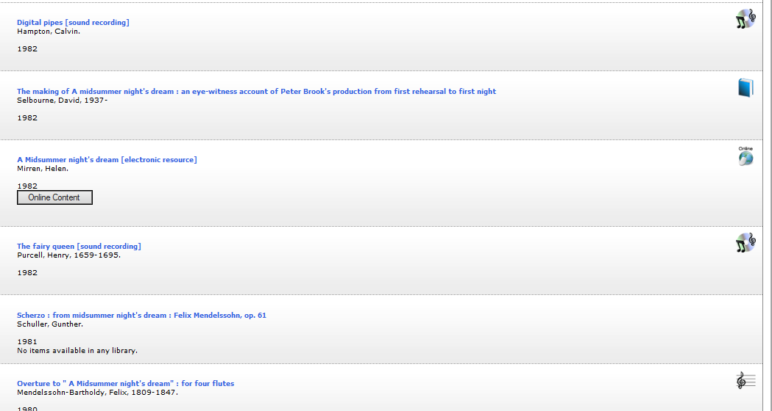
Classic Catalog Changes
More icons on the hit list display

Slide 40
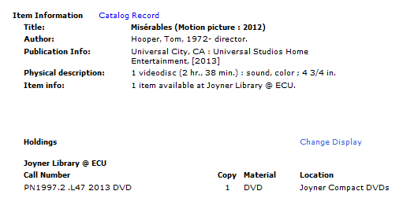
Classic Catalog Changes
Addition of 264 to Item Information display

Slide 41
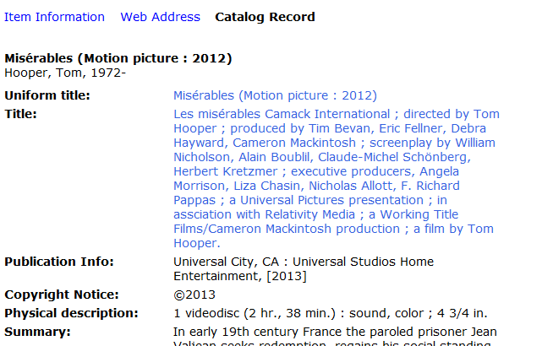
Classic Catalog Changes
Addition of 264 to Catalog Record display with relevant labels

Slide 42
Global Changes?
Do we want to add RDA elements to existing AACR2 records?
Programming vs contracted services
What’s super-important to our users?
Examples of possibilities include:
Adding relationship designators
Adding 336, 337, and 338 fields
Changing “S.l.” to “Place of publication not identified”

Slide 43
Why RDA?
Patricia Dragon

Slide 44
Why?
The practical answer: everybody’s doin’ it.
The bigger picture:
FRBR principles: find, identify, select, obtain
User-centered catalog code
FRBR model
AACR2 from pre-digital world
Importance of relationships
Importance of machine manipulation of data
Paving the way for successor of MARC (Bibliographic Framework Initiative)
Notes:
Patricia
Harder and more expensive to swim against the tide. For copy-cataloging, we really don’t have a choice but to accept RDA unless we withdraw from cooperative cataloging.
AACR2 was resource-centric. Impossible to imagine all the different kinds of resources there would be. Not bound by limits of catalog card.
Digital explosion means there are many more versions of things now (ebook, audiobook, computer game, etc.). AACR2 pre-digital meant cramming new formats in uncomfortably. RDA is extensible.
Relationship designators
AACR2 conceived in piece by piece cataloging world. Now more machine manipulation means need for more granularity. Take 264: publication date, distribution date, copyright date were all mushed into the same slot. RDA separates data points out.
Bibframe, linked data.
So how do we get from spelling out pages to the brave new recordless bibliographic world? Many changes we’ve talked about today are actually incidental to RDA (not the heart). MARC does not do RDA justice, but for now it’s all we have.

Slide 45
“The future has arrived. It’s just not evenly distributed yet.”—William Gibson
Notes:
Patricia

Slide 46
Wiki
http://easterncarolinanetworkcataloging.pbworks.com
Notes:
Patricia
To find a copy of this presentation and handouts from today. You’ll need to request access.

Slide 47
Questions?

